Slide 1
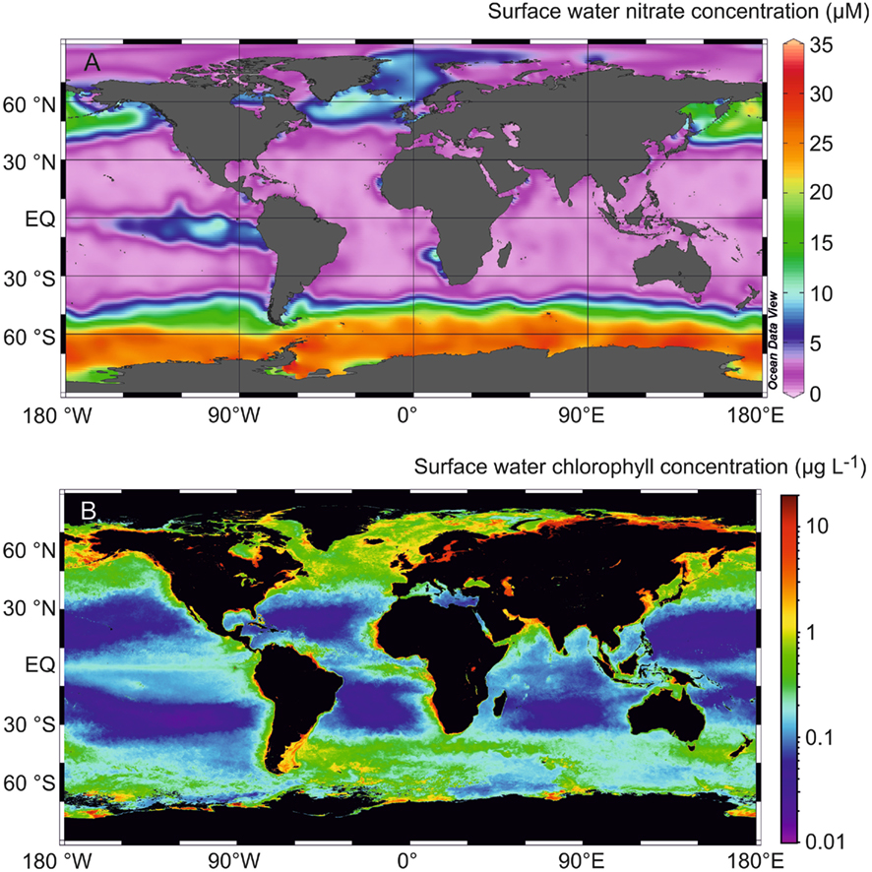
Nutrients and productivity IV
2 June
2017

Slide 2
Assignment (due before the test)
Go to www.egeotraces.org
Select the link in the top left hand corner “Sections”
Under “Select a data group” choose “Biogeochemical data”, and then from “Select a tracer”, choose an option that is interesting to you. You’ll see that the map below now has transects highlighted in red.
Click on a transect of interest, and the website will produce a section plot of your biogeochemical species (i.e., as a function of latitude), as well as a section plot of salinity, salinity with depth, and a TS plot.
Assignment: Explain, in terms of what you’ve learned about biogeochemical processes as well as ocean circulation, why the section looks the way it does. Consider both the vertical gradients and the horizontal changes. The salinity and TS data should help you with the circulation part. You can also look at hydrographic sections using egeotraces to help you.

Slide 3
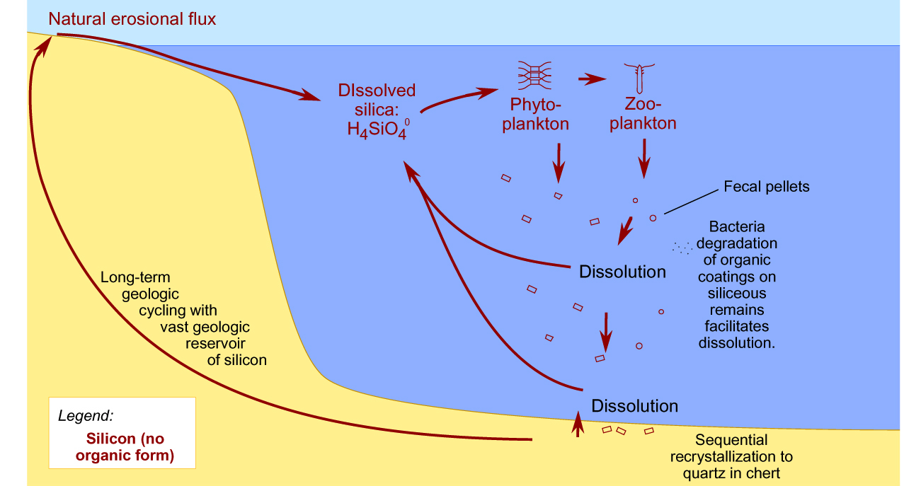
The marine silica (Si) cycle
Residence time
= ~10k years
Biogenic silica
Lithogenic
silica
Dissolved
silica Si(OH)₄
Dissolution rather than oxidative remineralization returns Si to a usable form (no organic form)

Slide 4
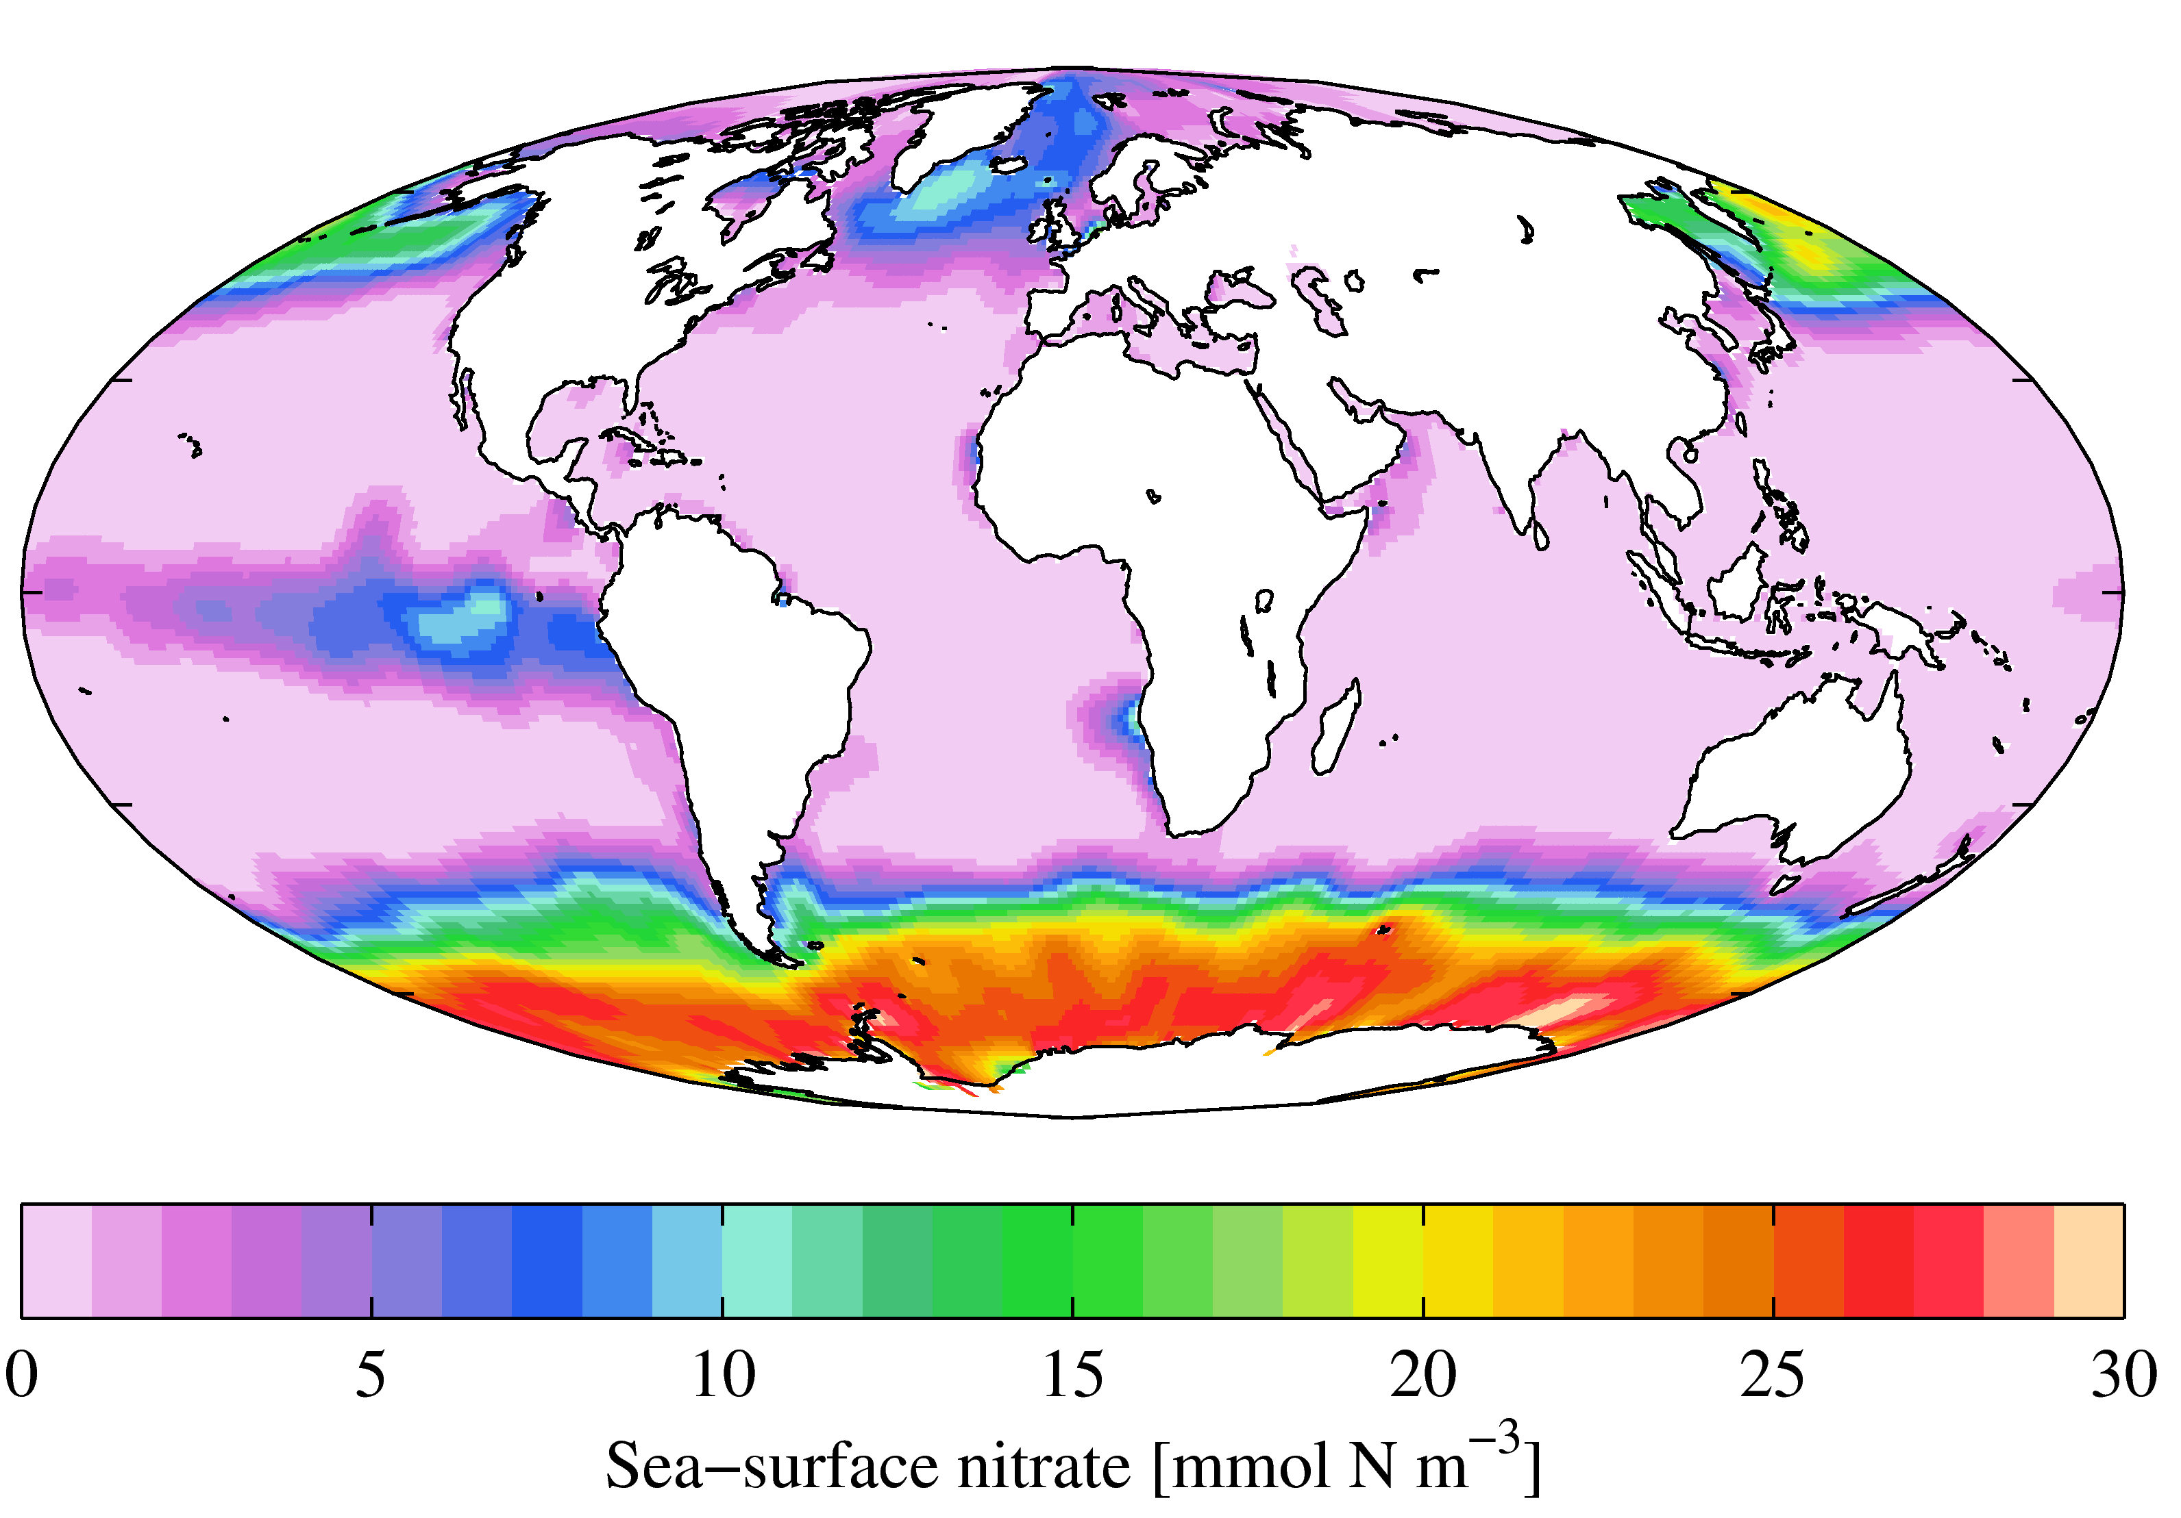
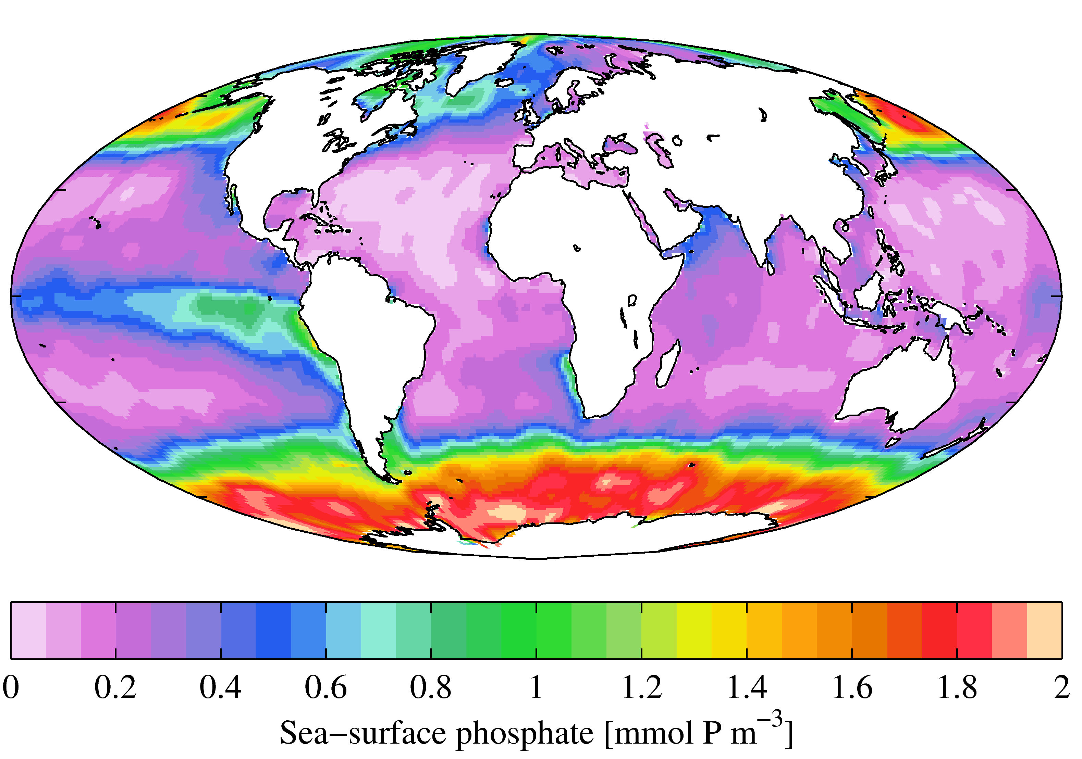
Surface [NO₃⁻] (μM)
Surface [PO₄³⁻] (μM)

Slide 5
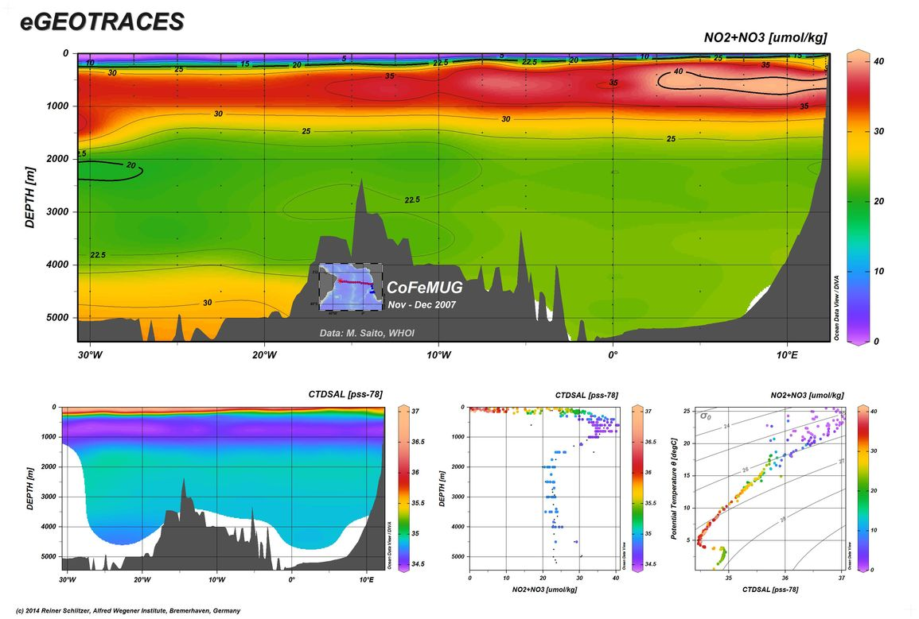
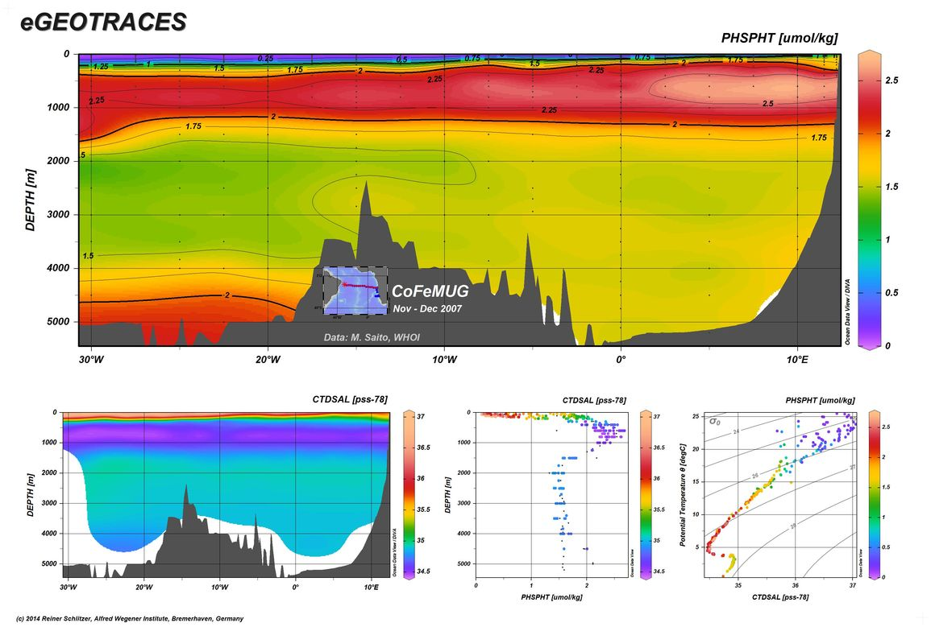
0
40
1000
30
2000
3000
20
4000
10
[NO₃⁻] (μmol/kg)
5000
0
30°W
20°W
10°W
0°
10°E
0
2.5
1000
2.0
2000
1.5
3000
1.0
4000
[PO₄³⁻] (μmol/kg)
0.5
5000
0
30°W
20°W
10°W
0°
10°E
http://www.egeotraces.org/

Slide 6
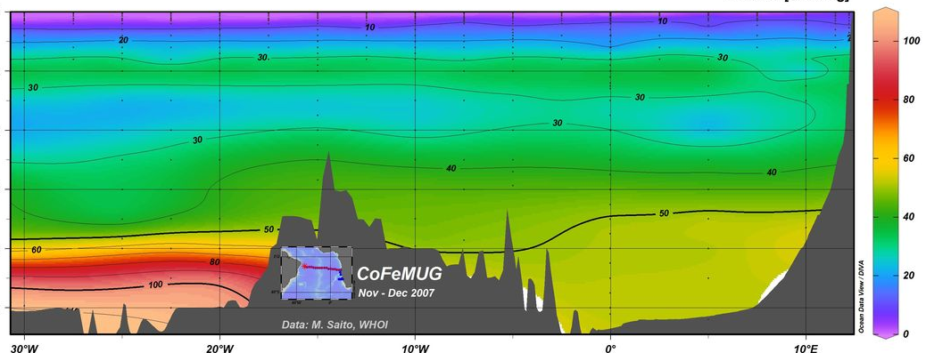
0
40
1000
30
2000
3000
20
4000
10
[NO₃⁻] (μmol/kg)
5000
0
30°W
20°W
10°W
0°
10°E
0
100
1000
80
2000
60
3000
40
4000
[Si(OH₄)] (μmol/kg)
20
5000
0
30°W
20°W
10°W
0°
10°E
http://www.egeotraces.org/

Slide 7
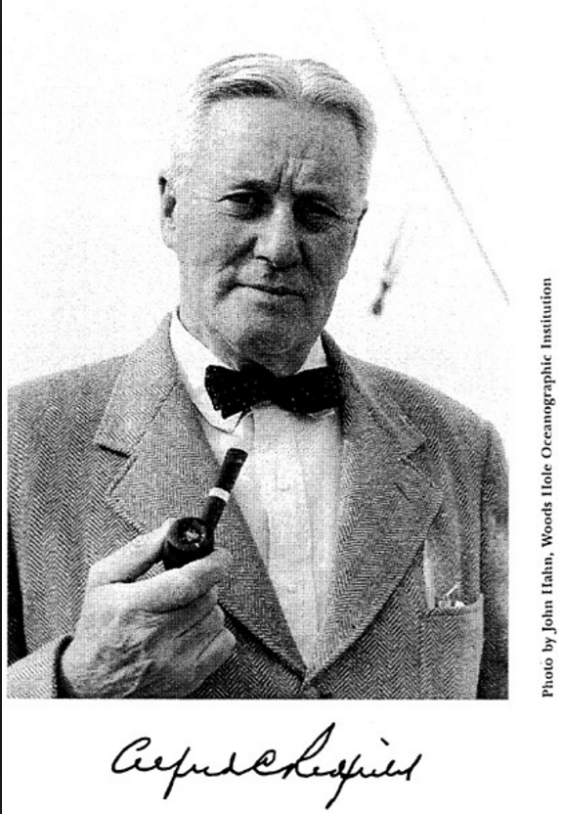
The Redfield ratio
C : N : P
106 : 16 : 1
Redfield A.C. (1934) On the proportions of organic derivatives in seawater and their relation to the composition of plankton. In James Johnson Memorial Volume (Ed. R.J. Daniel). University Press of Liverpool, pp. 177-192.

Slide 8
The Redfield ratio
source:
1) atmosphere
source:
1) geological/fluvial
C : N : P
source:
1) N₂ fixation
2) ocean subsurface
3) remineralization of OM
4) biological excretions
5) atmospheric N

Slide 9
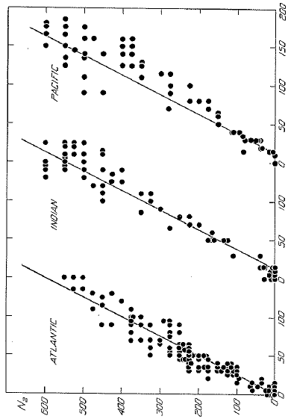
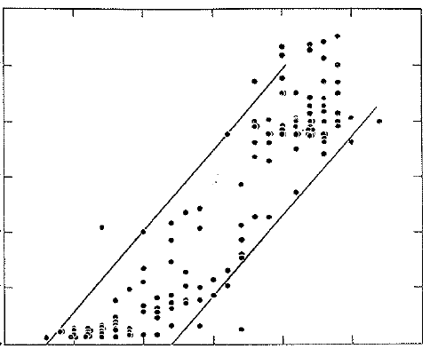
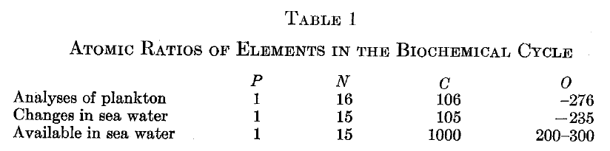
The Redfield ratio
ΔN:ΔP = 15-20:1
Atlantic
ΔN:ΔC = 15:106
Indian
Nitrate
Pacific
Phosphate
Carbon
Redfield 1934, 1958

Slide 10
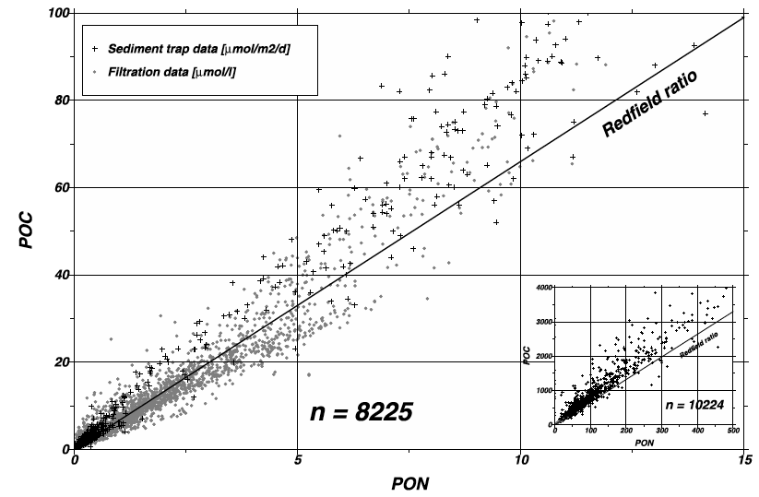
The Redfield ratio: biomass
Sinking and suspended
organic matter
ΔC:ΔN = 106:16 = 6.6:1
Particulate organic carbon (C)
Particulate organic nitrogen (N)
Schneider et al. 2003

Slide 11
The Redfield ratio: biomass
Average elemental/molar ratio of phytoplankton
106 CO₂ + 16 HNO₃ + H₃PO₄ + 78 H₂O ↔
(C₁₀₆H₁₇₅O₄₂N₁₆P) + 150 O₂
Remineralization: O₂:C_{org}:N:P ≈ -150:106:16:1
Remineralization: -O₂:C_{org}:N:P ≈ 150:106:16:1
Example: if PO₄³⁻ is observed to decrease by
0.5 μM due to phytoplankton growth, then nitrate is likely to have decreased by (0.5 x 16) = 8 μM

Slide 12
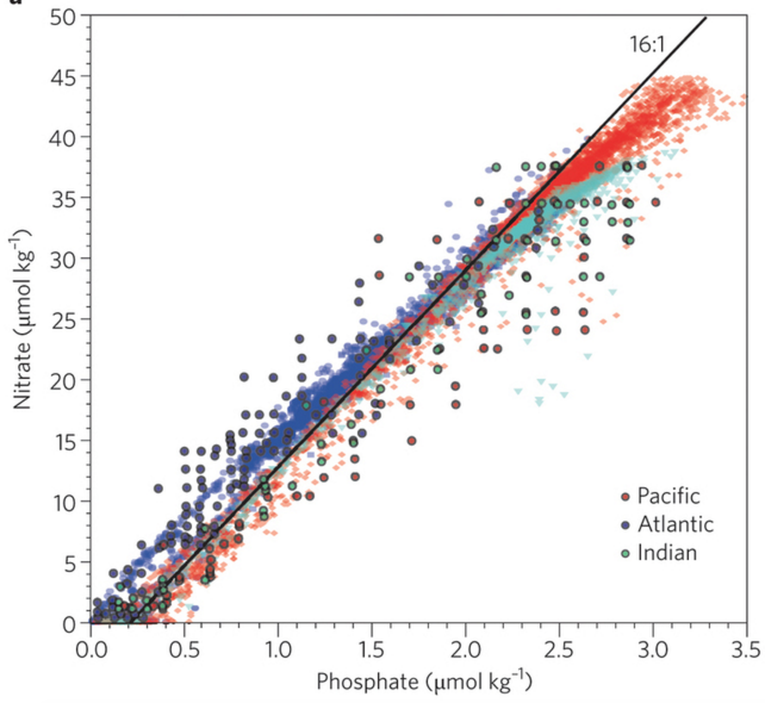
The Redfield ratio: nutrients
Gruber and Deutsch 2014

Slide 13
Why is the Redfield ratio useful?
Average elemental/molar ratio of phytoplankton
106 CO₂ + 16 HNO₃ + H₃PO₄ + 78 H₂O ↔
(C₁₀₆H₁₇₅O₄₂N₁₆P) + 150 O₂
Remineralization: -O₂:C_{org}:N:P ≈ 150:106:16:1
Example 1: if PO₄³⁻ is observed to decrease by
0.5 μM due to phytoplankton growth, then NO₃⁻ is likely to have decreased by ??

Slide 14
Why is the Redfield ratio useful?
Average elemental/molar ratio of phytoplankton
106 CO₂ + 16 HNO₃ + H₃PO₄ + 78 H₂O ↔
(C₁₀₆H₁₇₅O₄₂N₁₆P) + 150 O₂
Remineralization: -O₂:C_{org}:N:P ≈ 150:106:16:1
Example 1: if PO₄³⁻ is observed to decrease by
0.5 μM due to phytoplankton growth, then NO₃⁻ is likely to have decreased by (0.5 x 16) = 8 μM

Slide 15
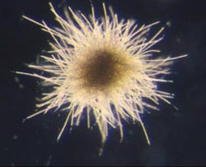
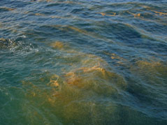
Deviations from Redfield stoichiometry
N₂ fixation
N₂ + 8 H⁺ + 8 e⁻ + 16 ATP → 2 NH₃ + H₂ + 16 ADP + 16 Pi
Generates ‘fixed N’ from unavailable N₂
Requires PO₄³⁻
Denitrification
C₁₀₆H₁₇₅O₄₂N₁₆P + 94.4 HNO₃ → 106 CO₂ + 55.2 N₂ + H₃PO₄ + 177.2 H₂O
Removes nitrate from the ocean as N₂ gas
Converts organic P to PO₄³⁻

Slide 16
Deviations from Redfield stoichiometry
N₂ fixation
N₂ + 8 H⁺ + 8 e⁻ + 16 ATP → 2 NH₃ + H₂ + 16 ADP + 16 Pi
Generates ‘fixed N’ from unavailable N₂
Requires PO₄³⁻
Denitrification
C₁₀₆H₁₇₅O₄₂N₁₆P + 94.4 HNO₃ → 106 CO₂ + 55.2 N₂ + H₃PO₄ + 177.2 H₂O
Removes nitrate from the ocean as N₂ gas
Converts organic P to PO₄³⁻
N:P ⬆

Slide 17
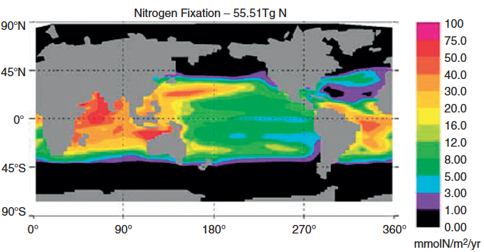
Input: N₂ fixation N₂(gas) → NH₄⁺
Moore et al. 2004

Slide 18
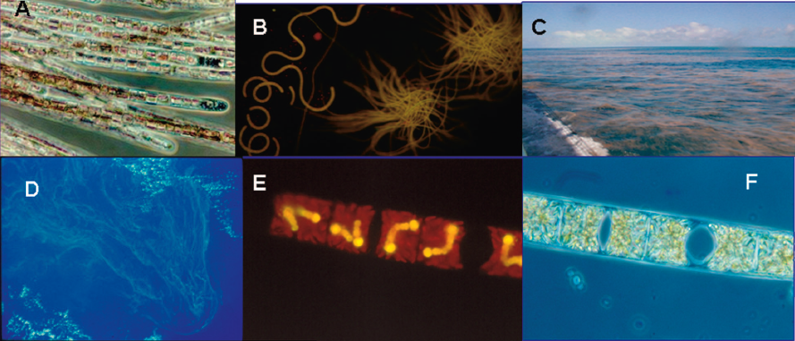
Input: N₂ fixation N₂(gas) → NH₄⁺
Trichodesmium spp. and DDAs

Slide 19
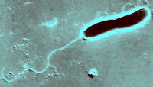
Deviations from Redfield stoichiometry
N₂ fixation
N₂ + 8 H⁺ + 8 e⁻ + 16 ATP → 2 NH₃ + H₂ + 16 ADP + 16 Pi
Generates ‘fixed N’ from unavailable N₂
Requires PO₄³⁻
Denitrification
C₁₀₆H₁₇₅O₄₂N₁₆P + 94.4 HNO₃ → 106 CO₂ + 55.2 N₂ + H₃PO₄ + 177.2 H₂O
Removes nitrate from the ocean as N₂ gas
Converts organic P to PO₄³⁻
N:P ⬆

Slide 20
Deviations from Redfield stoichiometry
N₂ fixation
N₂ + 8 H⁺ + 8 e⁻ + 16 ATP → 2 NH₃ + H₂ + 16 ADP + 16 Pi
Generates ‘fixed N’ from unavailable N₂
Requires PO₄³⁻
Denitrification
C₁₀₆H₁₇₅O₄₂N₁₆P + 94.4 HNO₃ → 106 CO₂ + 55.2 N₂ + H₃PO₄ + 177.2 H₂O
Removes nitrate from the ocean as N₂ gas
Converts organic P to PO₄³⁻
N:P ⬆
N:P ⬇

Slide 21
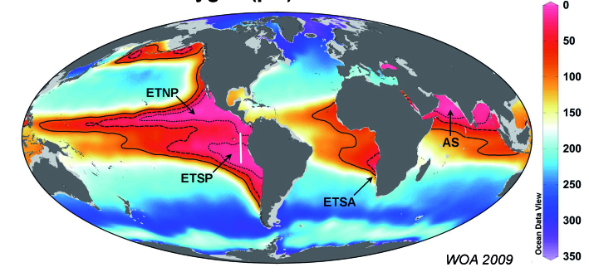
Output: Denitrification NO₃⁻ → N₂(gas)
[O₂] at 200 m (μmol/kg)
Major oxygen deficient zones (ODZ): ETNP, ETSP, Arabian Sea

Slide 22
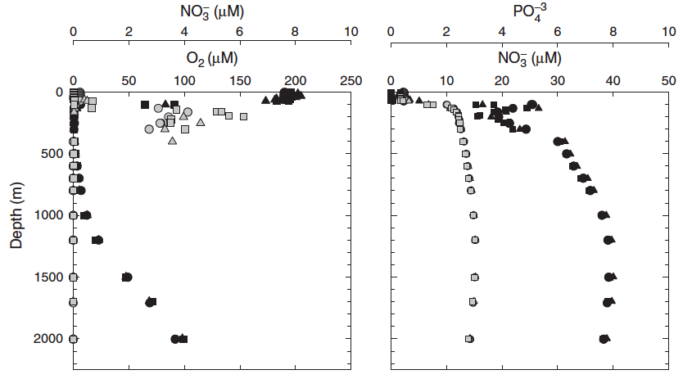
Output: Denitrification NO₃⁻ → N₂(gas)
Arabian Sea
[NO₃⁻]
Oxygen
[PO₄³⁻]
Devol 2008

Slide 23
Output: Denitrification NO₃⁻ → N₂(gas)
Arabian Sea
[NO₃⁻]
Oxygen
[PO₄³⁻]
Devol 2008

Slide 24
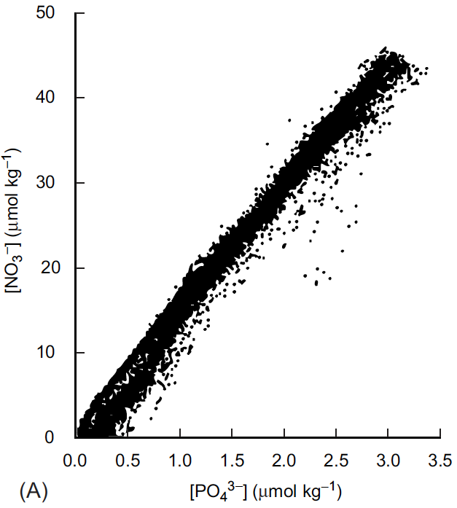
Deviations from Redfield stoichiometry

Slide 25
Deviations from Redfield stoichiometry
Upwelling followed by nutrient uptake with a 16:1 N:P ratio

Slide 26
Deviations from Redfield stoichiometry
Upwelling followed by nutrient uptake with a 16:1 N:P ratio
Excess P is consumed in the surface by N₂ fixation; N:P rises

Slide 27
Deviations from Redfield stoichiometry
Respiration of sinking OM raises NO₃⁻:PO₄³⁻ in a 16:1 ratio
Upwelling followed by nutrient uptake with a 16:1 N:P ratio
Excess P is consumed in the surface by N₂ fixation; N:P rises

Slide 28
Deviations from Redfield stoichiometry
Respiration of sinking OM raises NO₃⁻:PO₄³⁻ in a 16:1 ratio
N loss (denitrification)
in low O₂ waters and sediments decrease N and raises P
Upwelling followed by nutrient uptake with a 16:1 N:P ratio
Excess P is consumed in the surface by N₂ fixation; N:P rises

Slide 29
Deviations from Redfield stoichiometry
N₂ fixation
denitrification

Slide 30
Deviations from Redfield stoichiometry
106 CO₂ + 16 HNO₃ + H₃PO₄ + 78 H₂O ↔
(C₁₀₆H₁₇₅O₄₂N₁₆P) + 150 O₂
Remineralization: O₂:C_{org}:N:P ≈ -150:106:16:1
Example 2: if remineralization of organic matter is observed to draw down 10 μM O₂, then DIC should increase by (10 x 106/150) ≈ 7.1 μM and NO₃⁻ should increase by (10 x 16/150) ≈ 1.1 μM
Also applies to oxygen

Slide 31
Apparent oxygen utilization (AOU)
The O₂ distribution in the ocean is a result of:
surface equilibration with atmospheric O₂
biological production due to photosynthesis
biological use of O₂ during respiration and remineralization
increase in deep water O₂ due to sinking of cold, O₂-rich waters
To more easily interpret the physical and biological effects on O₂, we consider the amount that is utilized rather than the total O₂ concentration:
AOU (μmol/L) = [O₂]_{calc} – [O₂]_{meas}
[O₂]_{calc} = predicted [O₂] at given temperature and salinity

Slide 32
Apparent oxygen utilization (AOU)
The O₂ distribution in the ocean is a result of:
surface equilibration with atmospheric O₂
biological production due to photosynthesis
biological use of O₂ during respiration and remineralization
increase in deep water O₂ due to sinking of cold, O₂-rich waters
To more easily interpret the physical and biological effects on O₂, we consider the amount that is utilized rather than the total O₂ concentration:
AOU (μmol/L) = [O₂]_{sat} – [O₂]_{meas}
[O₂]_{sat} = predicted [O₂] at given temperature and salinity

Slide 33
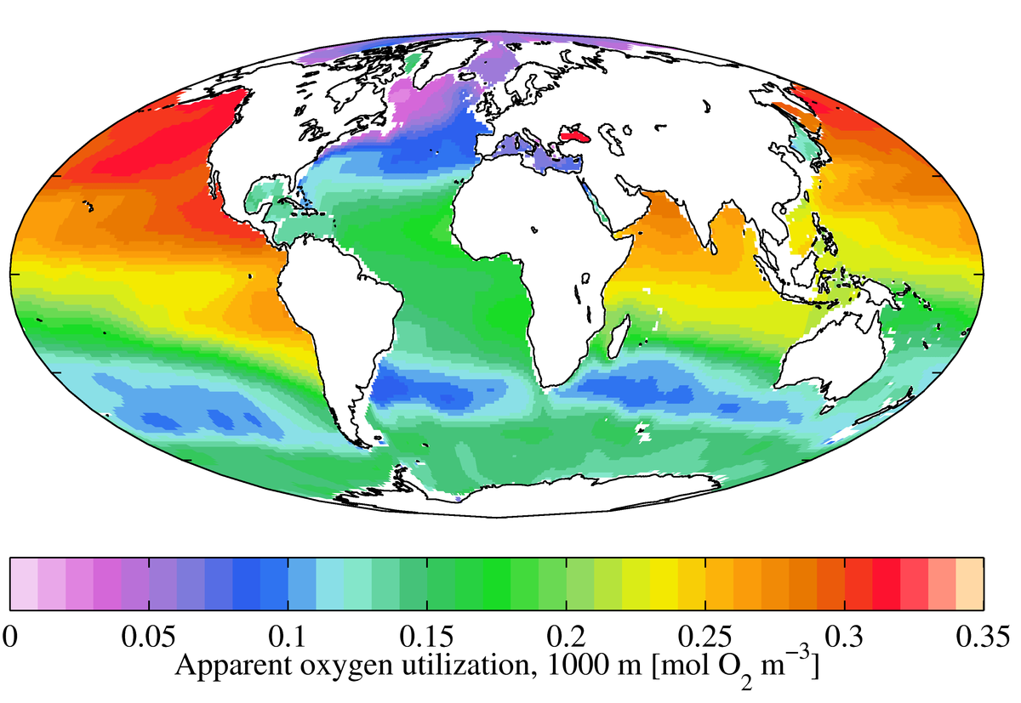
AOU at 1000 m

Slide 34
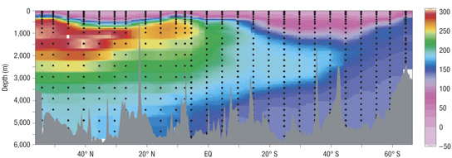
Apparent oxygen utilization (AOU)
AOU
μmol/kg
Pacific Ocean

Slide 35
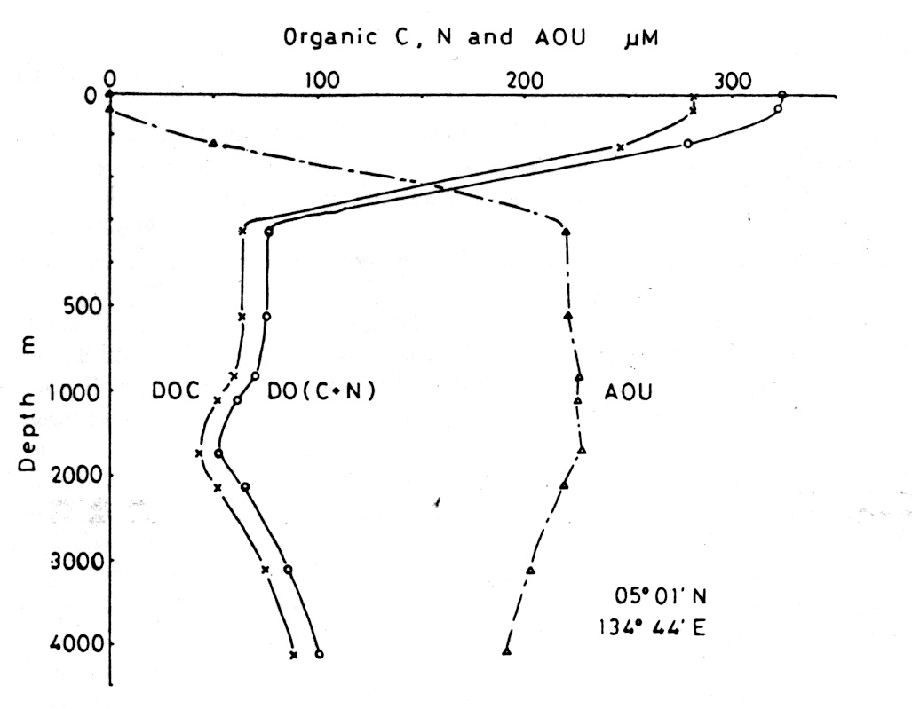
Apparent oxygen utilization (AOU)
AOU
Particulate organic carbon
Remineralization: AOU:C_{org}:N:P ≈ 150:106:16:1

Slide 36
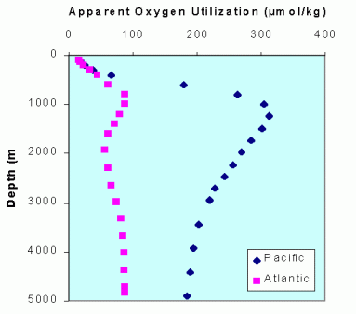
Apparent oxygen utilization (AOU)

